Slide 1


Lecture 2
Produced by Dr. Worldwide
Welcome to the 305
~
~

Slide 2

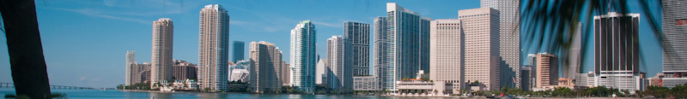
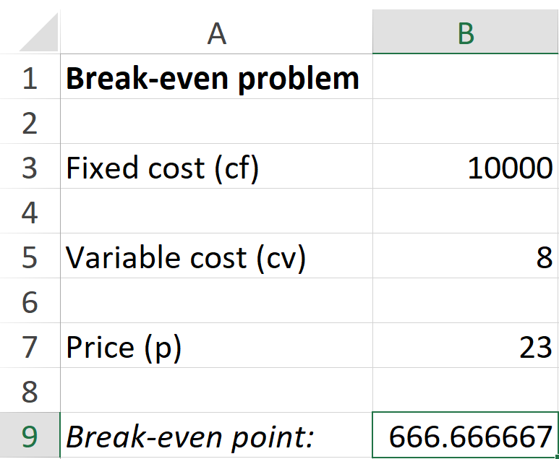

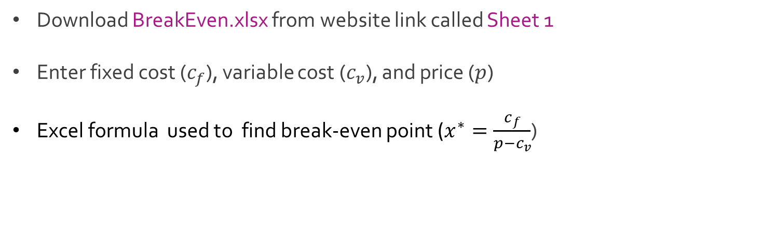
Excel: Break-Even
Download BreakEven.xlsx from website link called Sheet 1
Enter fixed cost ($c_{f}$), variable cost ($c_{v}$), and price ($p$)
Excel formula used to find break-even point ($x^{∗}=\frac{c_{f}}{p−c_{v}}$)

Slide 3

Excel: Break-Even
Use of Excel QM software for break-even analysis
Begin by opening Excel QM software from computer shortcut
Select Excel QM tab and select Alphabetical
In drop down menu, select Break-even Analysis and then Breakeven (Cost vs Revenue)
Enter name of report, sheet title, and insert checkmark for graph

Slide 4
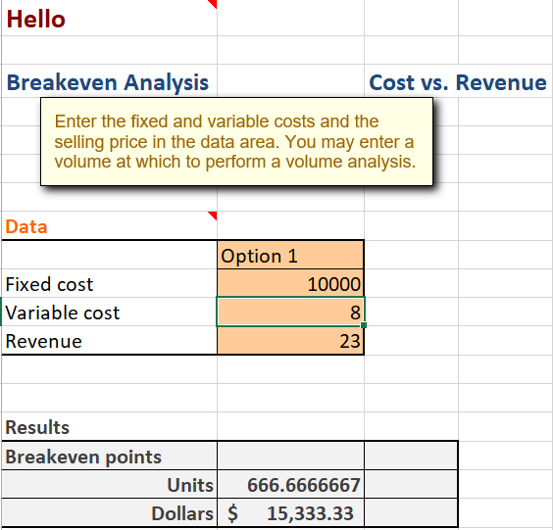
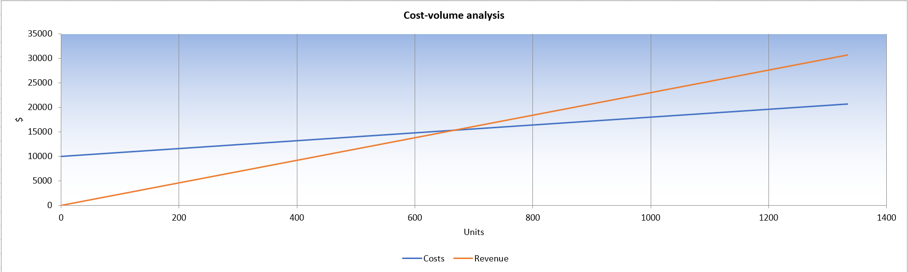
Excel: Break-Even

Slide 5
Ex: Production of Pottery
Beaver Creek Pottery produces the hottest clay bowls and mugs
Bowls require 1 hr. of labor and 4 lbs. of clay
Mugs require 2 hrs. of labor and 3 lbs. of clay
Daily Limitations of resources
40 hrs. of labor
120 lbs. of clay
Profit
Bowls return profit of $40
Mugs return profit of $50
Q: What number of clay bowls and mugs should the company make each day to maximize daily profit?

Slide 6
Linear Programming
Linear programming is the process of optimizing a linear objective function subject to linear constraints.
Seven steps of linear programming
Define the decision variables
Define the linear objective function
Use linear inequalities to define constraints
Graph resulting system of inequalities (use lines and shading)
Find the corners of the region
Substitute the coordinates of each corner into the objective function
Select the appropriate result based on when the objective function is optimized (either maximized or mininized) and interpret

Slide 7
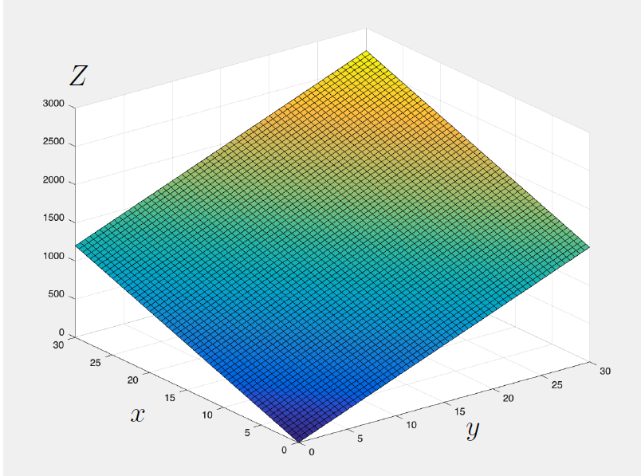
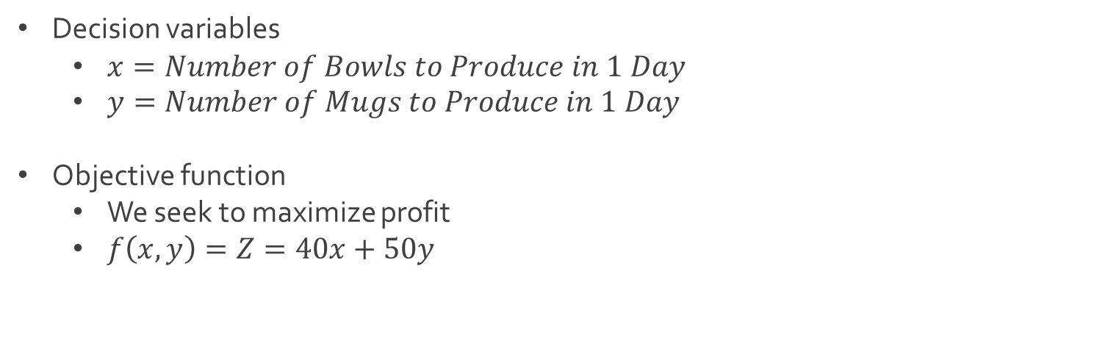
Ex: Production of Pottery
Decision variables
$x=Number of Bowls to Produce in 1 Day$
$y=Number of Mugs to Produce in 1 Day$
Objective function
We seek to maximize profit
$f\left(x,y\right)=Z=40x+50y$

Slide 8
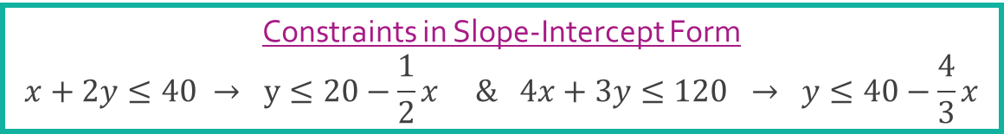

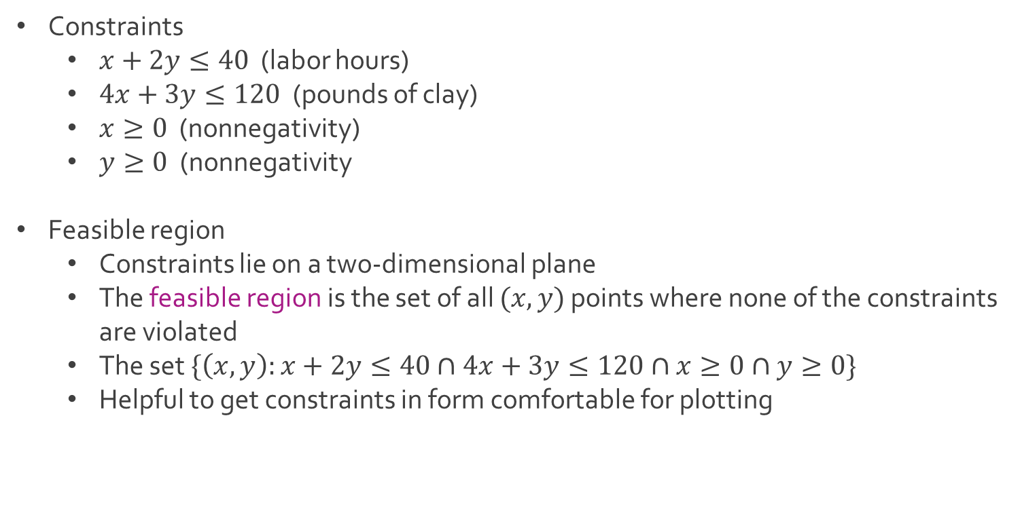
Ex: Production of Pottery
Constraints
$x+2y≤40$ (labor hours)
$4x+3y≤120$ (pounds of clay)
$x≥0$ (nonnegativity)
$y≥0$ (nonnegativity
Feasible region
Constraints lie on a two-dimensional plane
The feasible region is the set of all $(x,y)$ points where none of the constraints are violated
The set $\{\left(x,y\right):x+2y≤40∩4x+3y≤120∩x≥0∩y≥0\}$
Helpful to get constraints in form comfortable for plotting
Linear Program
Maximize $Z=40x+50y$
Subject to $x+2y≤40$
$4x+3y≤120$
$x≥0$
$y≥0$
Constraints in Slope-Intercept Form
$$x+2y≤40 → y≤20−\frac{1}{2}x \& 4x+3y≤120 → y≤40−\frac{4}{3}x$$

Slide 9
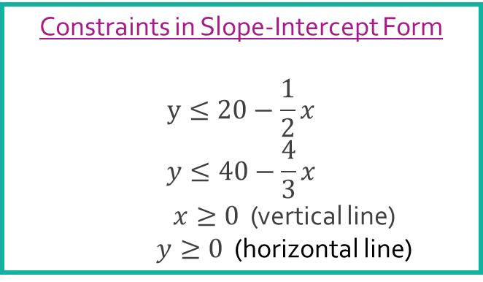
Ex: Production of Pottery
Plotting the feasible region
Based on nonnegativity constraints, the feasible region exists somewhere in the positive quadrant
Plot inequalities as if they were equalities
Shade according to the inequality symbol (check if the origin satisfies the inequality or not
The feasible region is the intersection of the shaded areas
Constraints in Slope-Intercept Form
$$y≤20−\frac{1}{2}x$$
$$y≤40−\frac{4}{3}x$$
$x≥0$ (vertical line)
$y≥0$ (horizontal line)

Slide 10
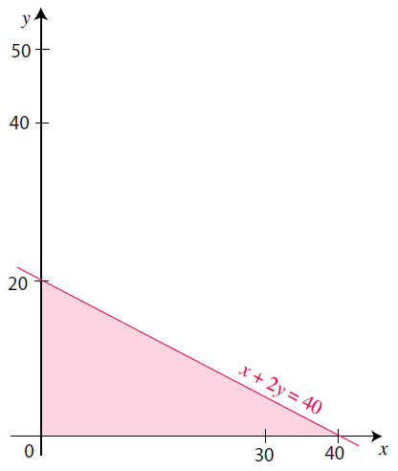
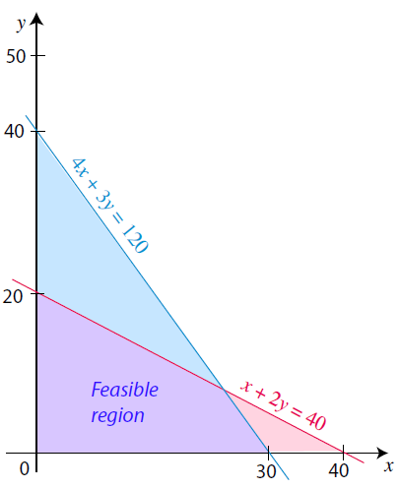
Ex: Production of Pottery
Plotting the feasible region (Continued)

Slide 11


Ex: Production of Pottery
Find the corners of the feasible region
Origin: $(0,0)$
Intercepts: $(0,20)$ & $(30,0)$
Intersection Point: $(24,8)$
$$y=20−\frac{1}{2}x=40−\frac{4}{3}x=y$$
$$−\frac{1}{2}x+\frac{4}{3}x=20$$
$$\frac{5}{6}x=20$$
$$x=24$$
When x=24,
$$y=20−\frac{1}{2}∗24=8$$

Slide 12

Ex: Production of Pottery
Find the corners of the feasible region (Continued)
Optimal choice of decision variables is one of the corner points around feasible region
Plug into objective function
Find optimal solution and interpret
Ideally, we want to produce 24 bowls and 8 mugs
This decision will lead to a maximum profit of $1360
Corner Points and Profit
$$\left(0,0\right)→40\left(0\right)+50\left(0\right)=\$0$$
$$\left(0,20\right)→40\left(0\right)+50\left(20\right)=\$1000$$
$$\left(30,0\right)→40\left(30\right)+50\left(0\right)=\$1200$$
$$\left(24,8\right)→40\left(24\right)+50\left(8\right)=\$1360$$

Slide 13
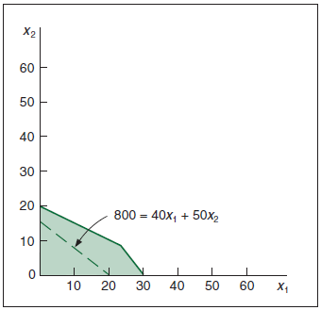
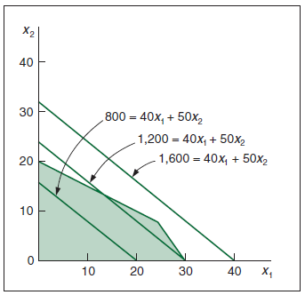








Ex: Production of Pottery
Another creative look at finding the optimal solution
Recall the objective function: $Z=40x+50y$
$$y$$
$$y$$
$$800=40x+50y$$
$$1200=40x+50y$$
$$1600=40x+50y$$
$$800=40x+50y$$
$$x$$
$$x$$

Slide 14
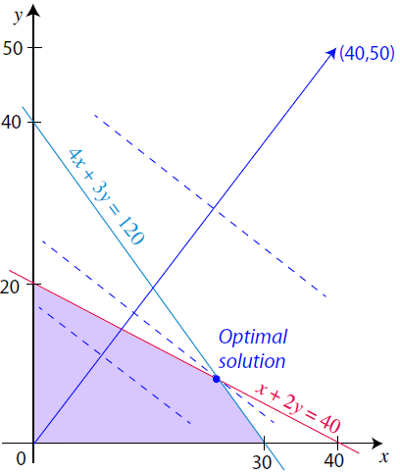

Ex: Production of Pottery
Another creative look at finding the optimal solution (Continued)
Objective function grows in the direction of the vector $\left(40,50\right)$
Lines that are perpendicular to this vector are level curves
In a maximization problem, the optimal solution will be the point in the feasible region farthest in the direction of growth

Slide 15
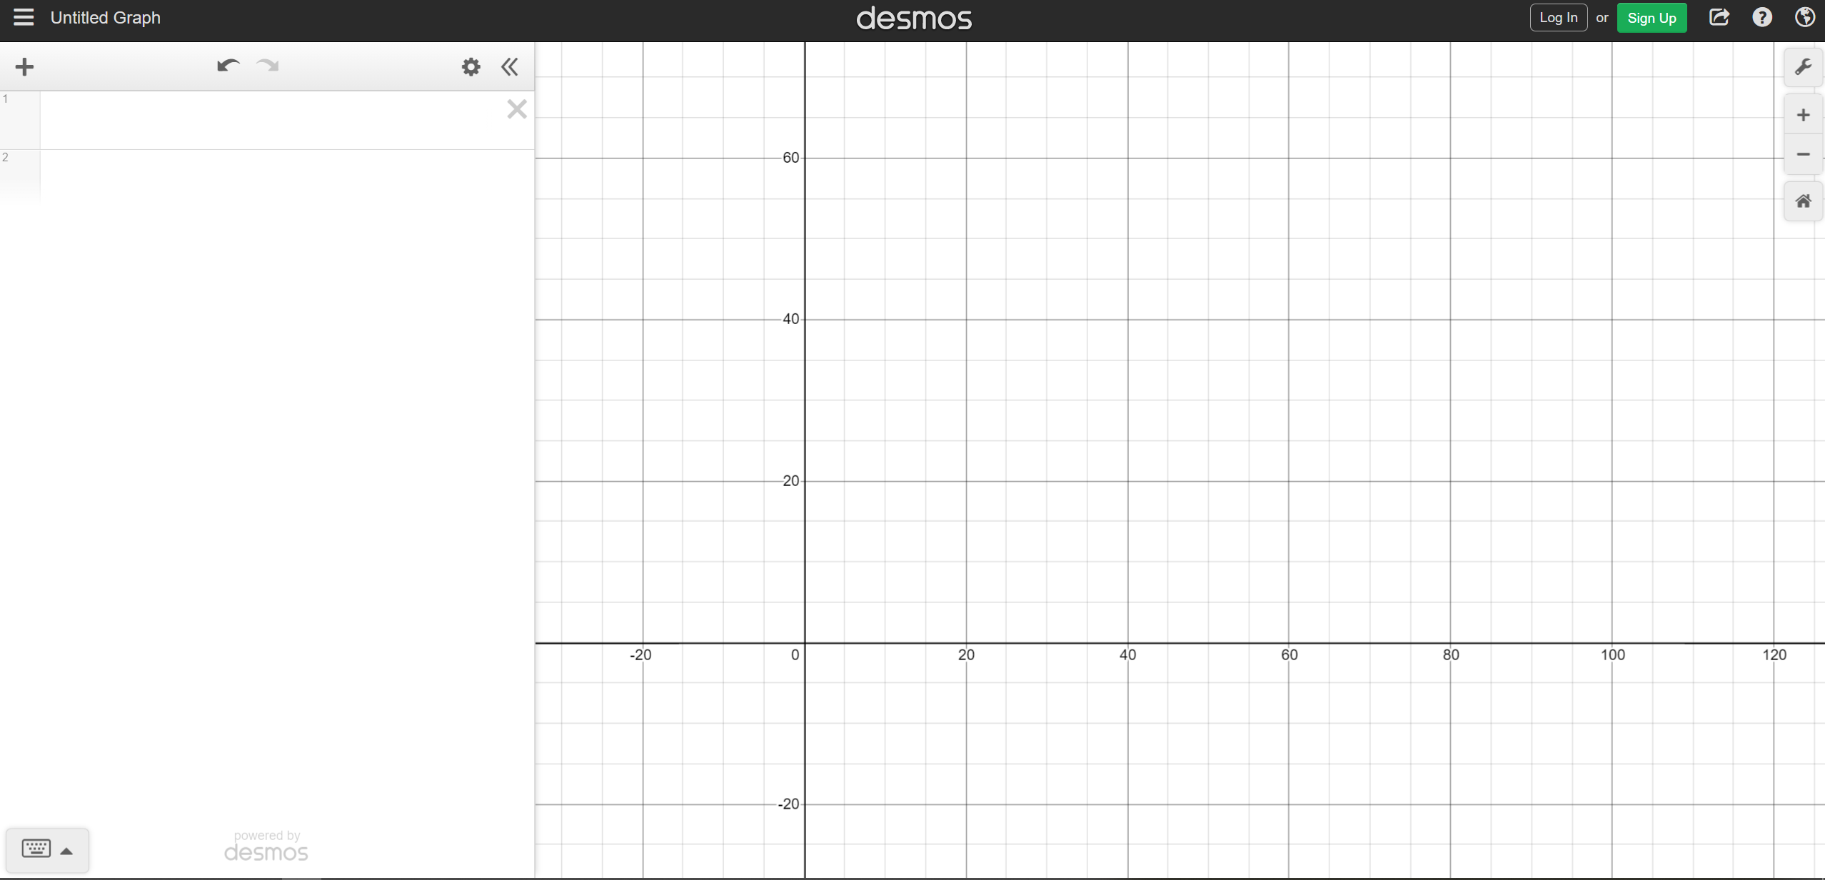
Using Desmos
Use Link Provided on Course Website for Online Graphing Calculator
Start with a Blank Coordinate Plane and Zoom Out as Necessary

Slide 16
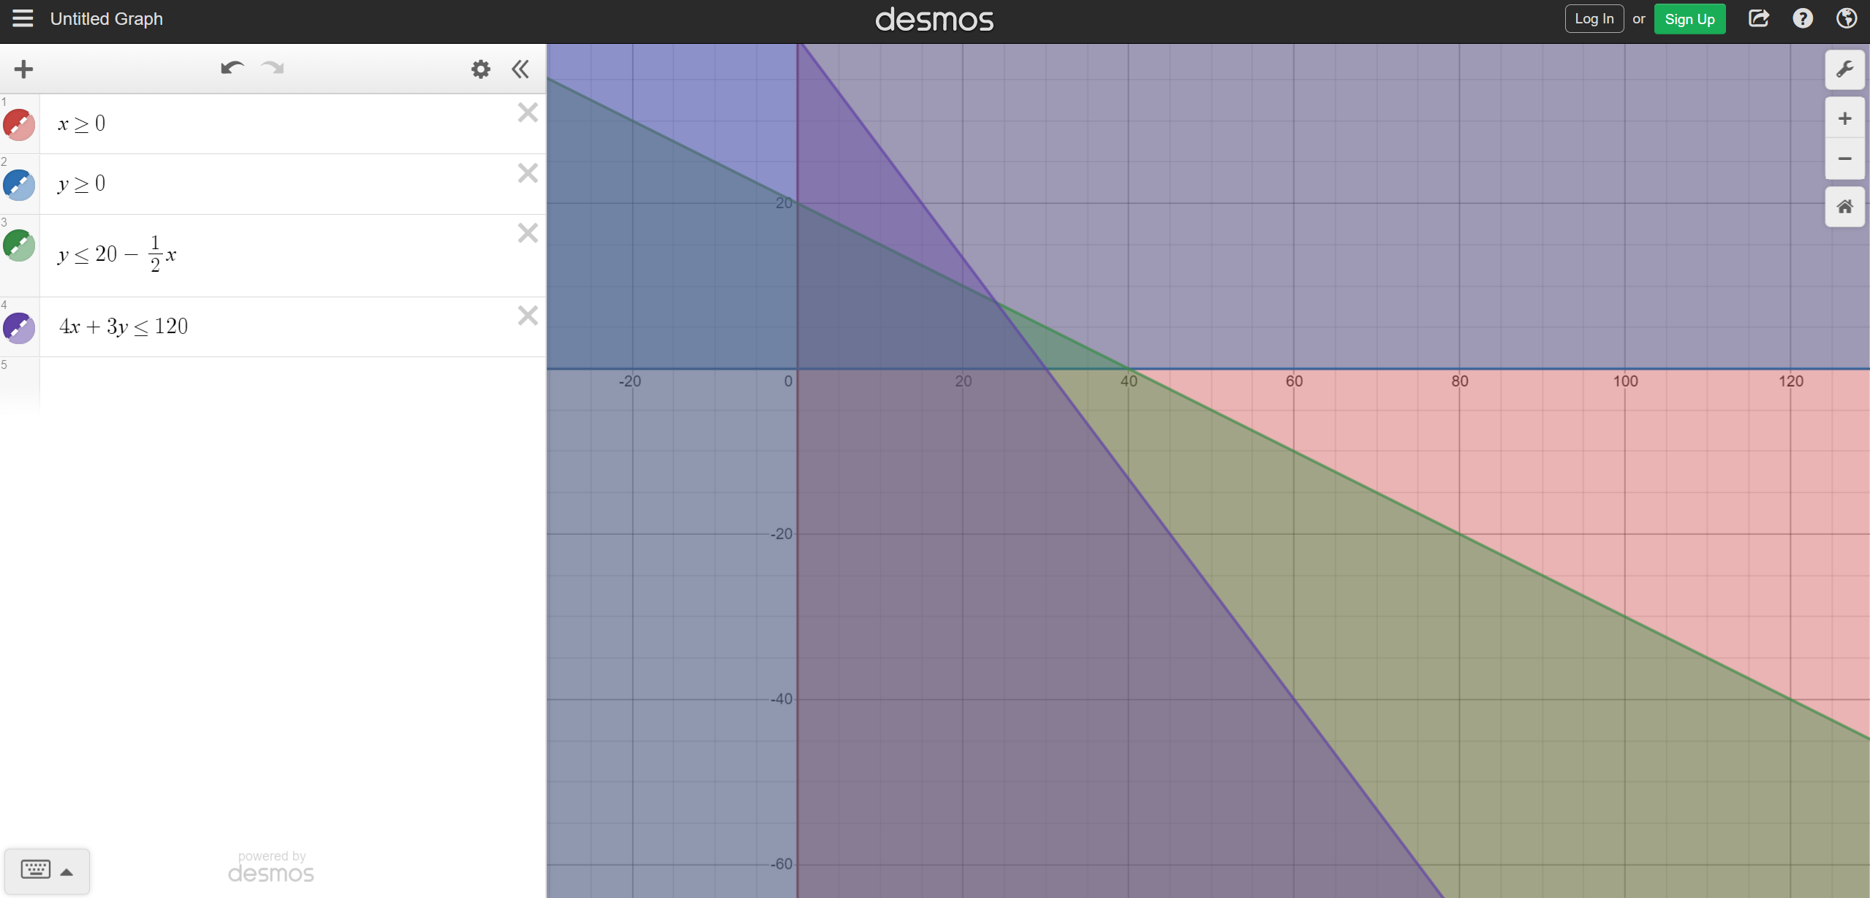
Using Desmos
Type Inequalities for Constraints in the Left Panel

Slide 17
Using Desmos
Darkest Region Represents the Feasible Region
Points of Intersection Can Be Easily Selected
Need to Use a Screen Shot to Capture Image to Save on Your Computer

Slide 18




The End
Dale

